Slide 1
AI Methodology
06

Slide 2

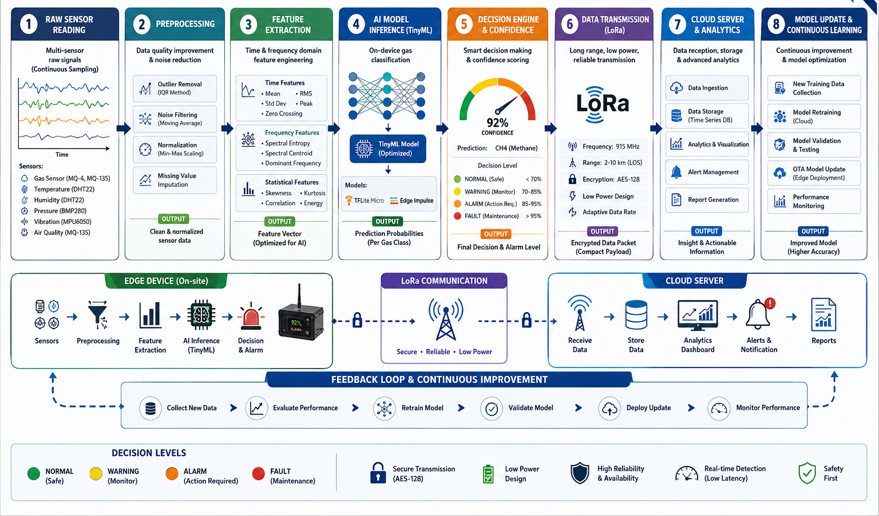

Slide 3
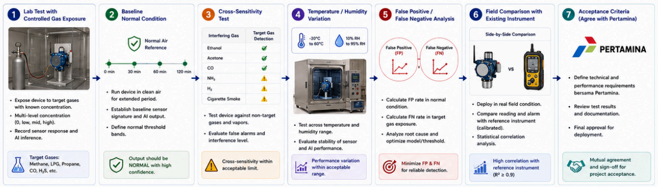
Model Validation Plan

Slide 4
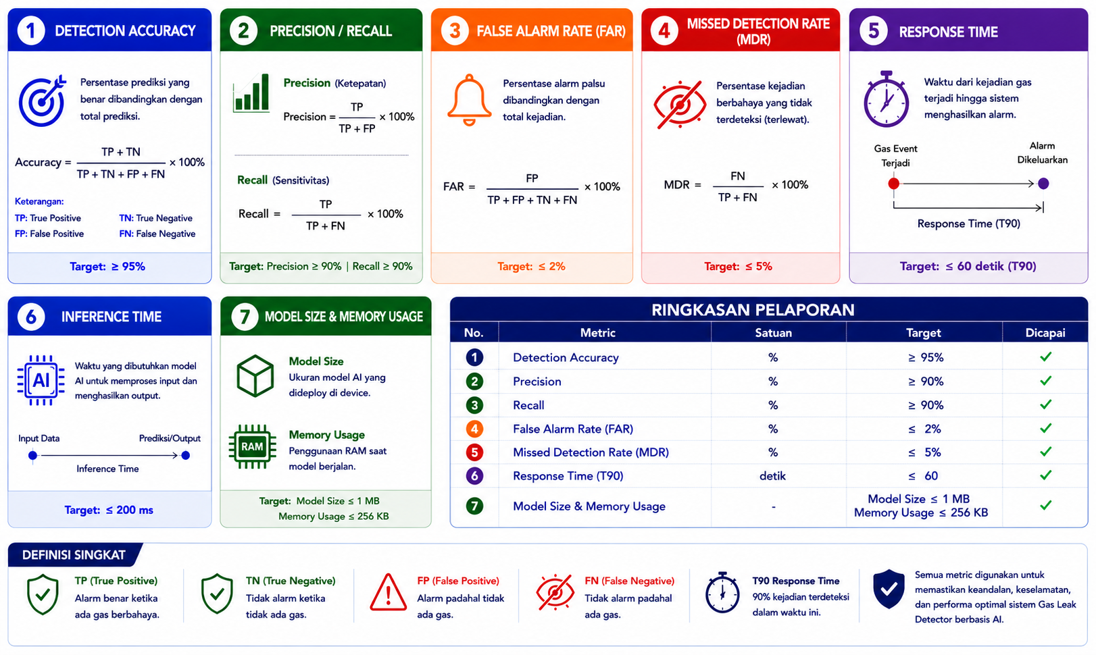
AI Performance Metrics

